Slide 1
Nevada Department of Transportation
2024 Nevada Transportation Conference
Jae Pullen, P.E.
May 7, 2024

Slide 2
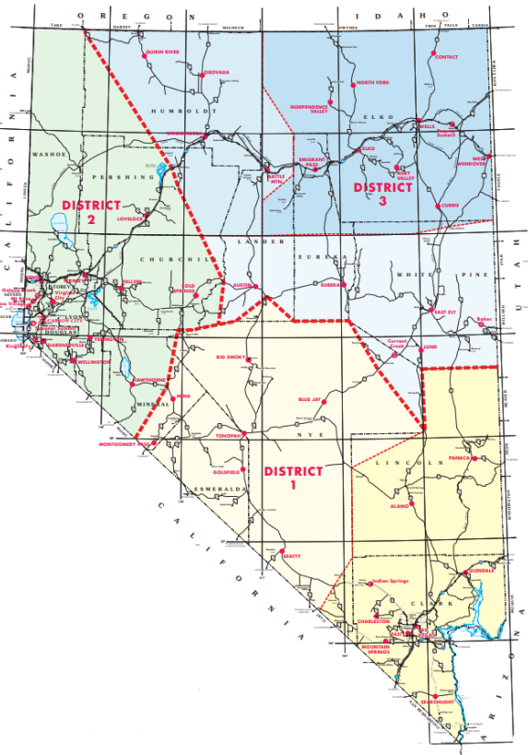
Nevada DOT Overview
Number of FTEs: 1,951 plus temporary/seasonal
Major Divisions
  Administration & Planning
  Project Delivery & Engineering
  Operations & Maintenance
Number of Maintenance Districts: 3
  With 3 major subdistricts
STATE HIGHWAY SYSTEM
Bridges: 1,246
Lane Miles: 13,532

Slide 3
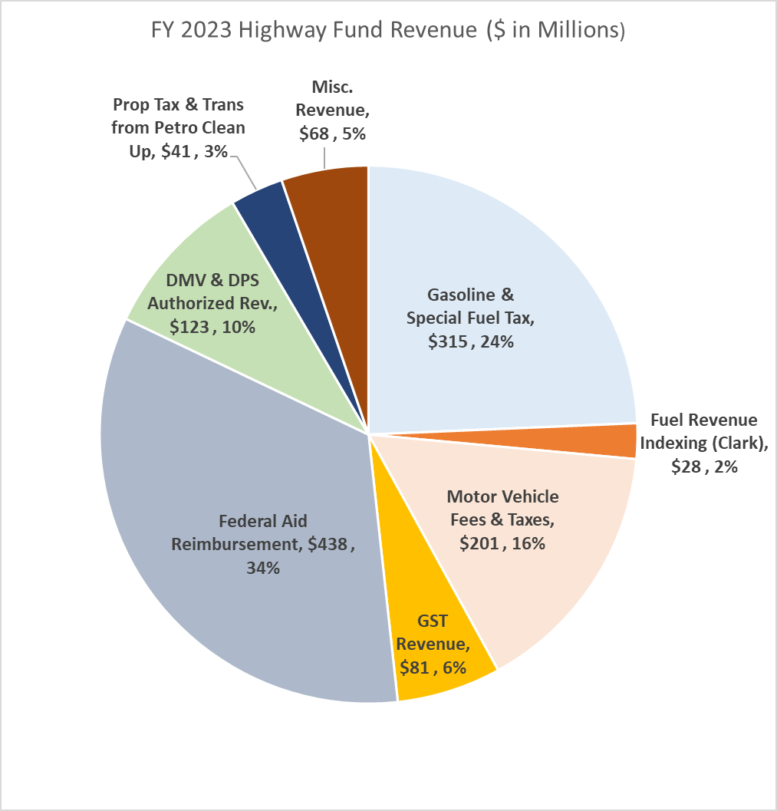
FY2023 Nevada Highway Fund Revenue Sources)
$1.29B STATE HIGHWAY FUND REVENUE
Motor Vehicle Fees & Taxes - $201M
$132.6M - Registration and Bicycle Safety Fees
$45.6M - Motor Carrier Fees
$22.9M - Driver's License Fees
Misc Revenue - $68M
$22.9M - Appropriations from Other Funds
$12.8M - Interest
$12.0M - Cooperative Construction Reimb.
$20.3M - Other Misc. Revenue

Slide 4
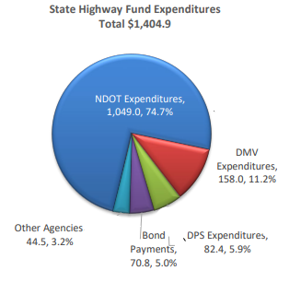
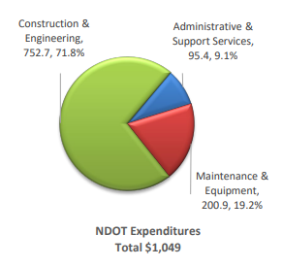
State Highway Fund Expenditures – FY 2023

Slide 5
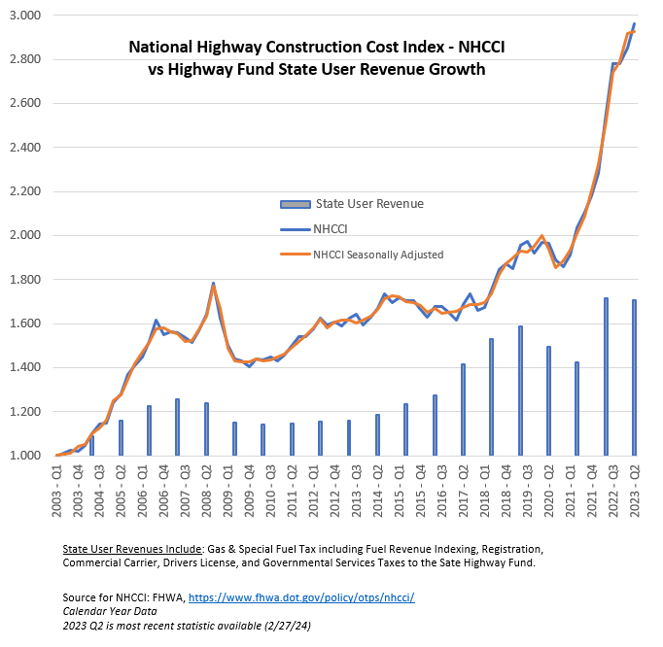
Inflation Outpaces Revenue Growth

Slide 6

Staff Vacancies

Slide 7
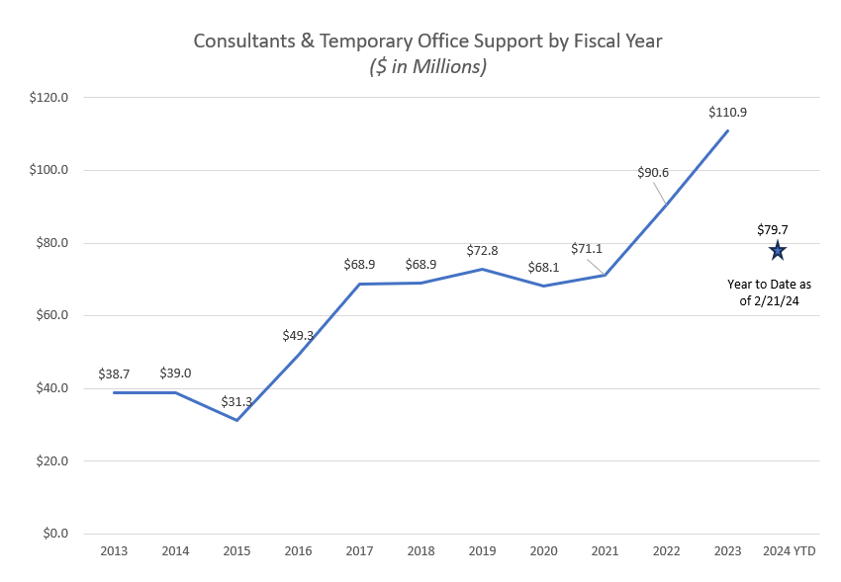
Vacancies Create Need for Outsourcing

Slide 8
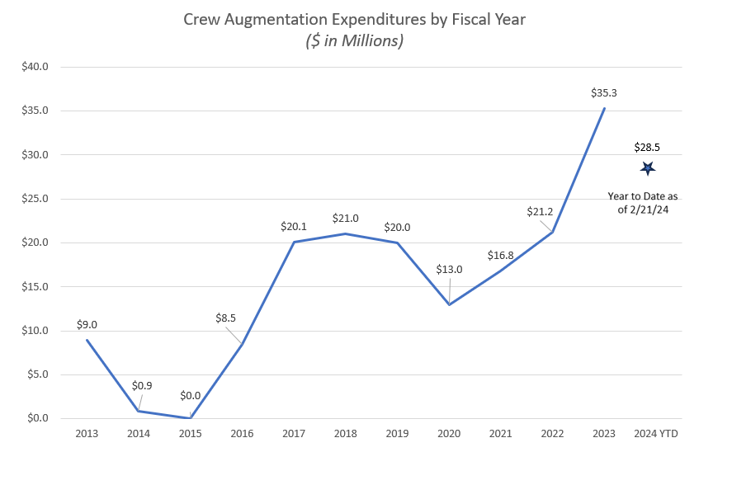
Construction Crew Augmentation

Slide 9






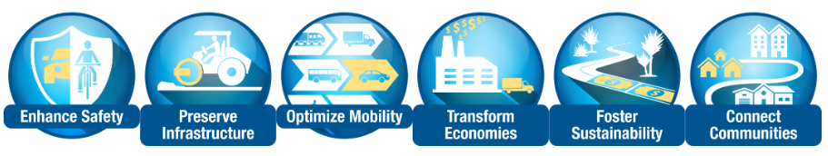
What is the One Nevada Process?
A data-driven, transparent process to identify and fund the best projects that achieve NDOT’s One Nevada Goals.
One NV Goal Areas
Long-Range Need Identification
Identify data-driven needs that are not being addressed and advance those needs into action
Needs Validation
Validate needs using data and shepherd valid needs forward to action
Mid-Range Program Level Prioritization
Evaluate project concepts using consistent NDOT process as well as division specific processes to recommend priority projects
Unconstrained Project List
Identify comprehensive list of projects to be considered for funding (coordinating the 5-year plan and STIP parking lots)
STIP & AWP Project Prioritization
Rank projects according to ability to meet One Nevada Goals and Cost Effectiveness
STIP & AWP Harmonization
Harmonize the program of projects based on funding eligibility, project readiness, performance targets, and geographic distribution

Slide 10







2024-2029 NDOT Strategic Plan Update
Our new structured approach to guide our decision-making processes and set priorities for achieving our long-term goals
OUR WHY
Vision
What does the organization aim to accomplish, why does it exist, and what principles and beliefs drive its actions?
Mission
Core Values
OUR WHAT
What are the main priorities and goals of the organization to fulfill its vision and mission?
Goal Areas
Strategic Goals
How does the organization plan to achieve its goals, and how will it measure its progress and success?
OUR HOW
Strategies and Action Items
Performance Measures

Slide 11


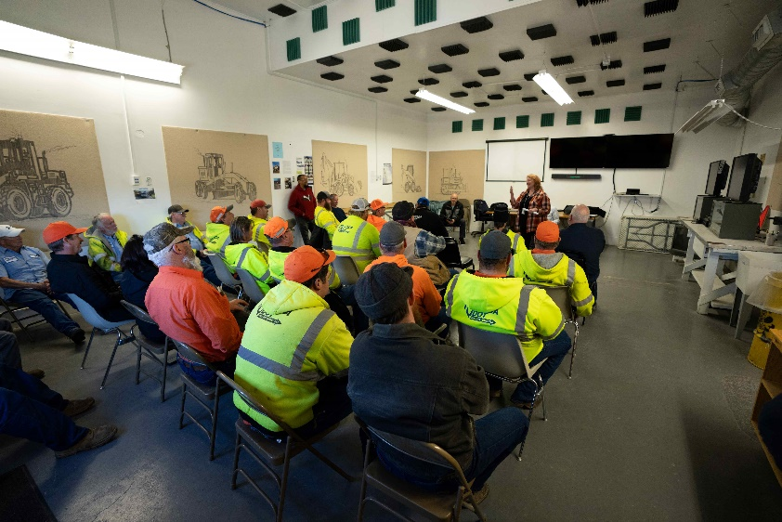

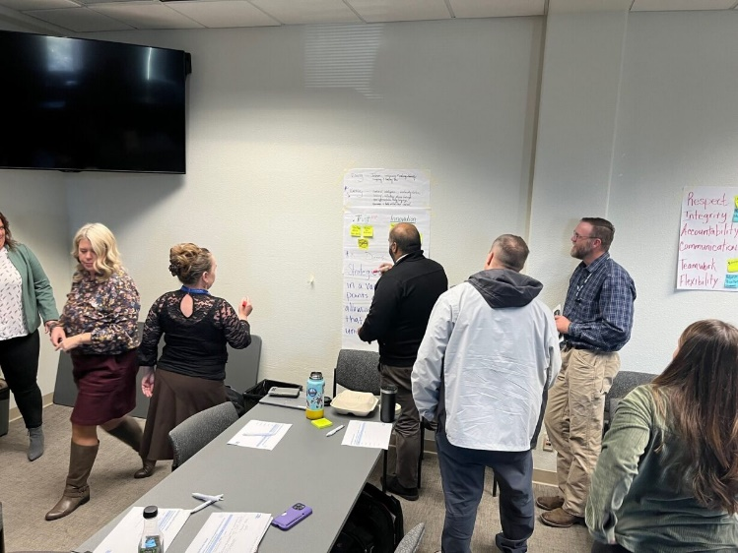
What We Have Done So Far
We are thrilled to share an update on our NDOT Strategic Plan 2024-2029. We have collaborated with our team, stakeholders, and external partners, achieving significant insights and milestones.
On April 10th, we met with division heads and refining these strategies collaboratively into a focused list of must-have strategies, driving subsequent detailed action plans.
Division Heads Interviews
All NDOT Survey
Asset Management Workshops
Focus Groups
Current Plans Review
Best Practices Review
Strategies
Performance Measures
External Summits
Strategic Goals
In-person Listening Sessions
Vision, Mission, & Core Values

